Slide 1

Quantitative Hedge Fund Strategies
Discretionary Long-Short Strategy

Slide 2
02
Akash Mahant
Cheshta Virani
THE TEAM
Pragati Kumar
Shivang Dholaria

Slide 3
TODAY'S AGENDA
Introduction
Data preprocess and Implemention
Results
Conclusion
03

Slide 4
INTRODUCTION
DESIGNING AND BACKTESTING A DISCRETIONARY LONG/SHORT EQUITY STRATEGY
UNIVERSE DEFINITION:
Focused on S&P 500 stocks.
Historical data was retrieved for analysis.
STRATEGY DEFINITION:
Bottom-up approach targeting individual S&P 500 stocks.
Strategy revolves around identifying stock's mean return for subsequent quarter.
Trading Rules:
Focus on identifying reversals, emphasizing poor-performing stocks from the preceding quarter.
Quarterly execution with a one-quarter holding period.
Backtest:
Cumulative returns calculated for the defined strategy.
Comparison against S&P 500 benchmark.
Results visualized through plots, and numerical outcomes stored in a DataFrame.
Notes:
In order to Design and backtest a quantitative investment strategy we covered several aspects starting with the Universe Definition:The Universe Definition served as the The foundation of our strategy.we meticulously selected stocks within the S&P 500. And By extracting ticker symbols from an Excel file, we procured historical data for these stocks, which acted as the stage for the in-depth analysis.
Then the second aspect was Strategy Definition:
Our strategy adopted a bottom-up approach, focusing on individual stocks within the S&P 500.The logic involved identifying the poorest-performing stocks in each quarter based on cumulative returns.

Slide 5
DATA PREPROCESS AND IMPLEMENTATION
Use historical data from 2018 form training
Load 500 Stocks data. Extract ticker symbols
Calculate cumulative returns for the Strategy
Displaying backtesting results
Calculate cumulative returns for S&P 500
Selecting stocks based on specified criteria for each quarter

Slide 6
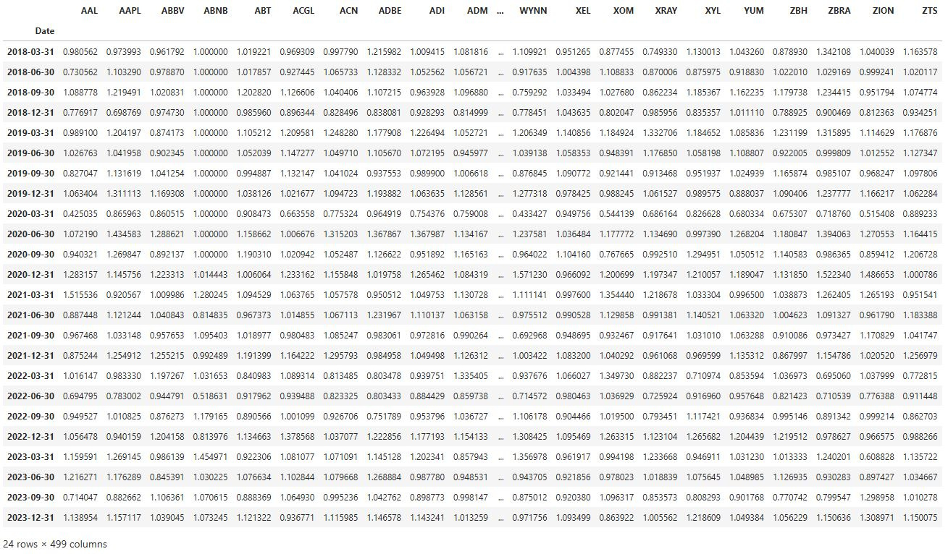
Stock Prices Returns

Slide 7
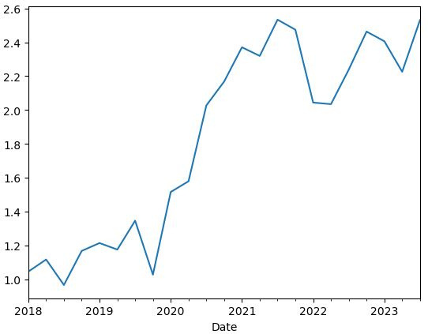
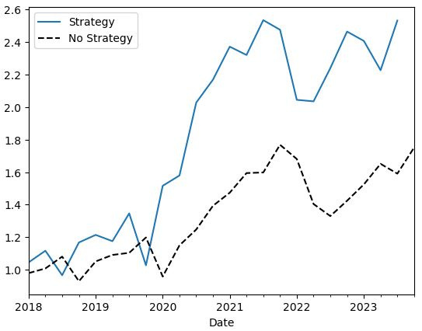
RETURNS
Graph 1 illustrates the quarterly returns over the past 5 years, showcasing the effectiveness of our stock-holding strategy
Graph 2 compares quarterly returns against the S&P 500 index, offering insights into the relative performance of our strategy in each quarter.

Slide 8
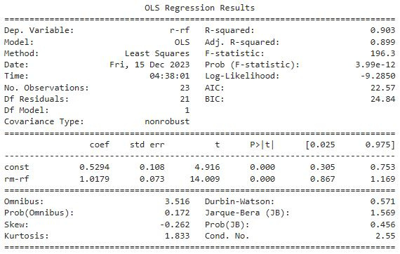
REGRESSION ANALYSIS

Slide 9



RESULTS
Gross Return/ Net return (Transactions costs included) | 16.6997%
R squared | 0.903
Tracking Error | 0.3451
Standard Deviation | 0.1498
Drawdown | -0.440
Beta | 0.5294
Alpha | 1.0179
Notes:
Positive alpha - excess return that the benchmark
beta 0.5 - strategy is less risky
high R2 - good model for the given data
-0.44 drawdown - investment fell 44% from its highest point
It is a substantial magnitude.

Slide 10
Thank you

